Slide 1
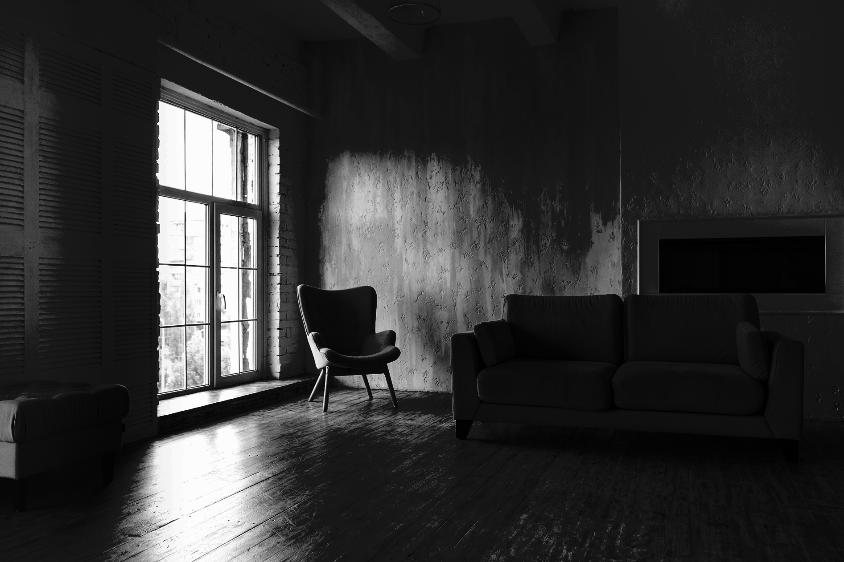
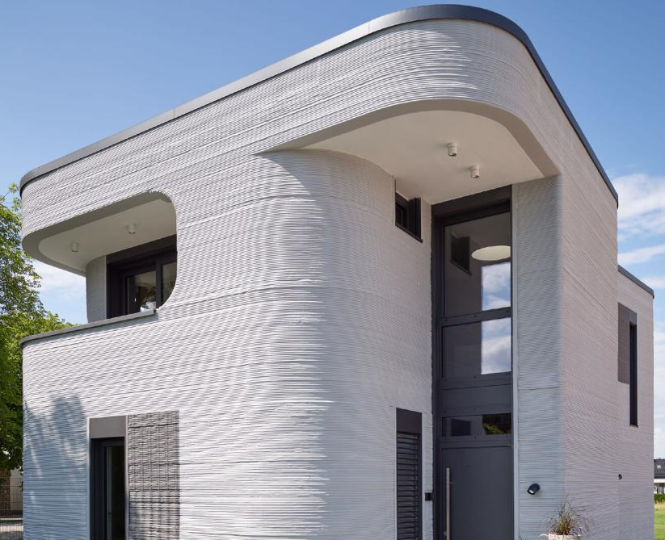

3Dwell -
King County
Property
Evaluation
Presented by Jordan Mang, Garrett Hall, Charles Pan
Aka the John Lim Fan Club
Notes:
We are John

Slide 2
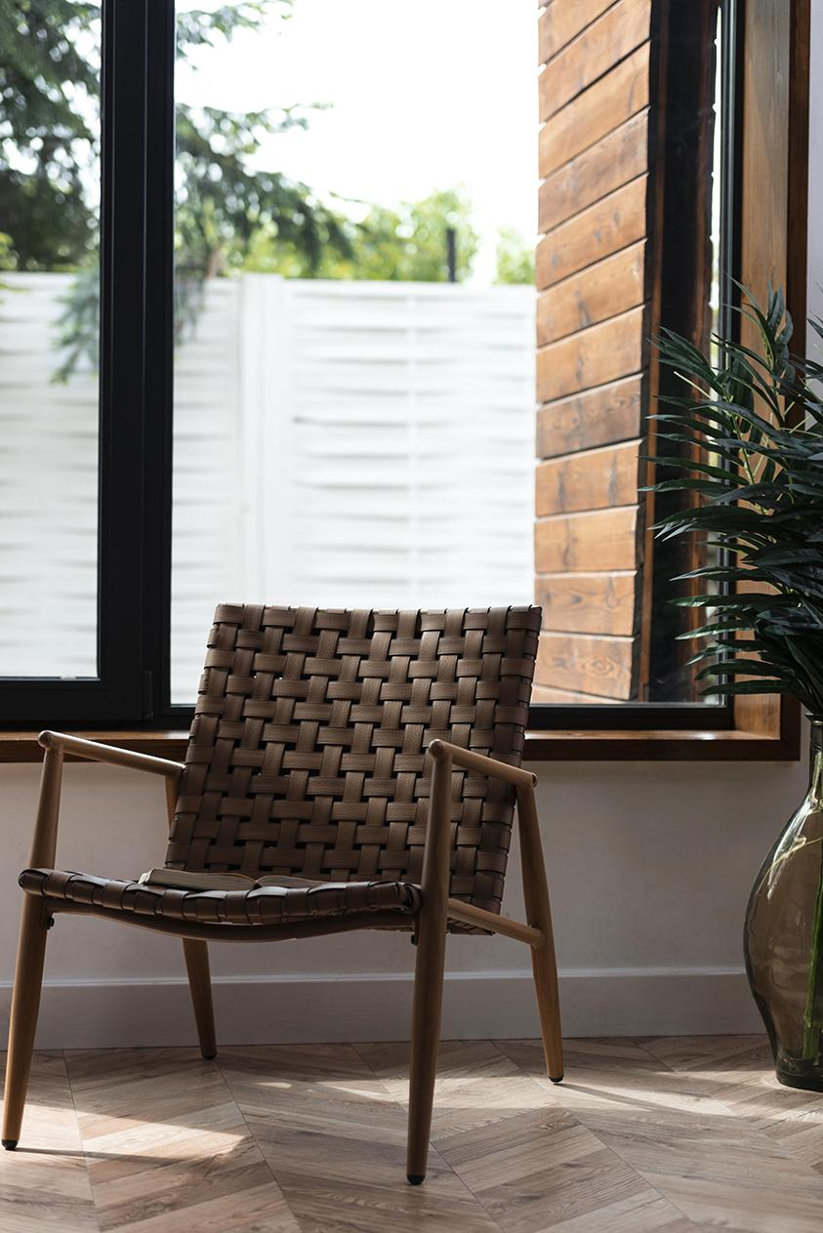


Mission Statement
3Dwell, is an emerging business that 3D prints affordable homes and is looking for a site in King County for their model home.
Notes:
3d Dwell is a start up that prints 3D homes and is looking to place their first model home in King County to acquire both investors and new clients.
-Charles

Slide 3

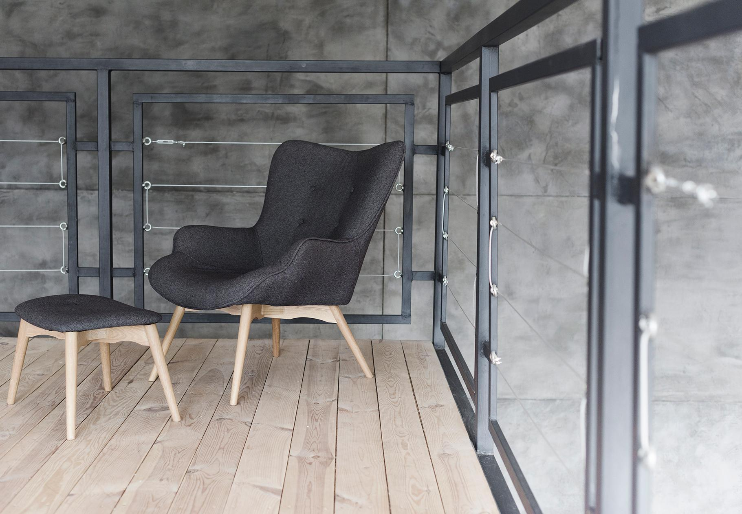
Business Problem
Acquire and tear down a poor quality home
1600 - 2600 square feet
Has a good view
Estimate the cost for this home
Notes:
Because King county is so developed, 3Dwell has asked us to find information on low quality house for a tear down and replace with a house of roughly the same size. It is important to our client that we locate neighborhoods with “good” quality views as they hope to use photos of their model home in their social media roll-out. They would like us to make 3 recommendations for areas of Seattle for their model home as well as predictions of the cost.

Slide 4
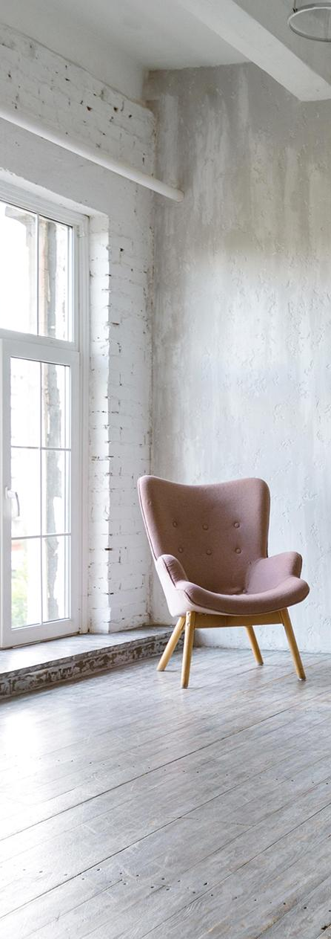
Presentation Overview
Market
Timing
Current market outlook
Best time due to supply or high sales
Price Estimations
Recommendations
Provided by our top of the line predictive model
Our top three recommendations
Notes:
In our presentation, we will be going over the market trend, the best market timing, a price estimation provided by our top of the line predictive model, and three recommendations that will satisfy our client
-Charles

Slide 5
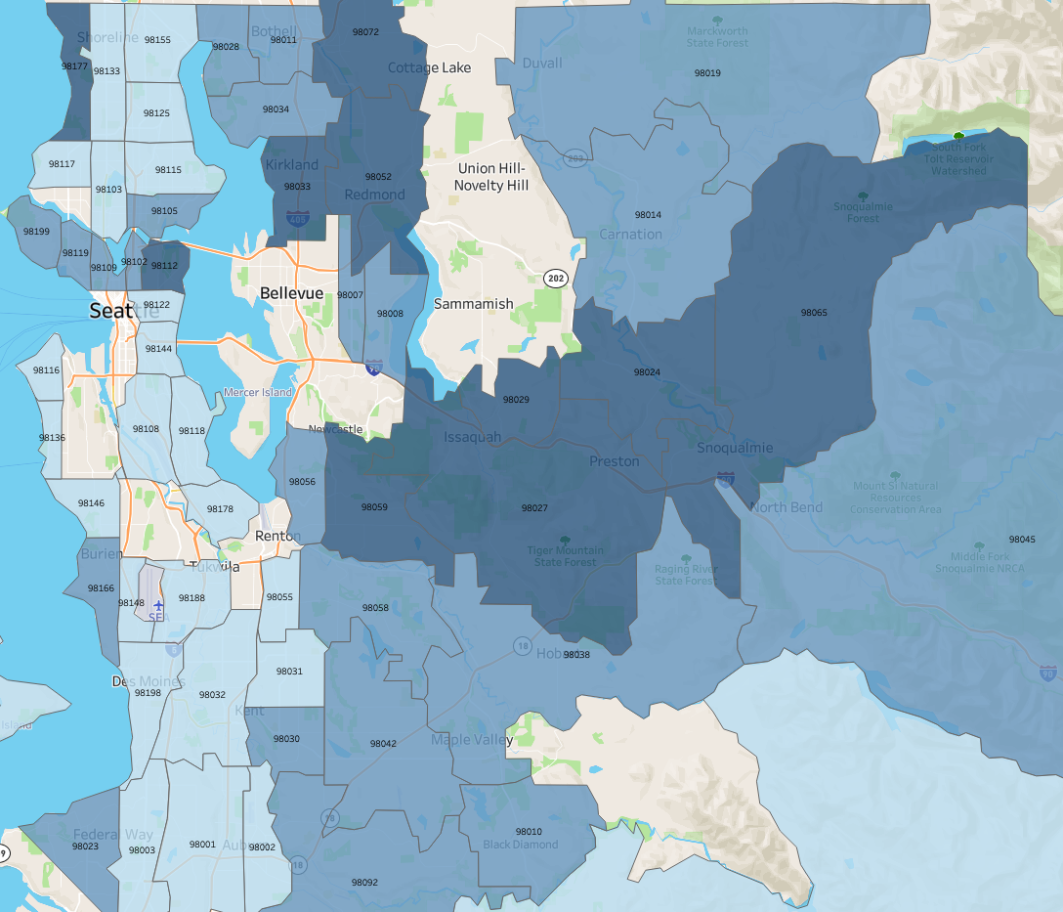
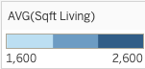
Market Analysis
Sq. Footage by Zip Code
22 neighborhoods fulfill home requirement
South East King County suited for a larger model home.
West Side of Seattle is generally for suited for smaller model home.
Notes:
Jordan

Slide 6
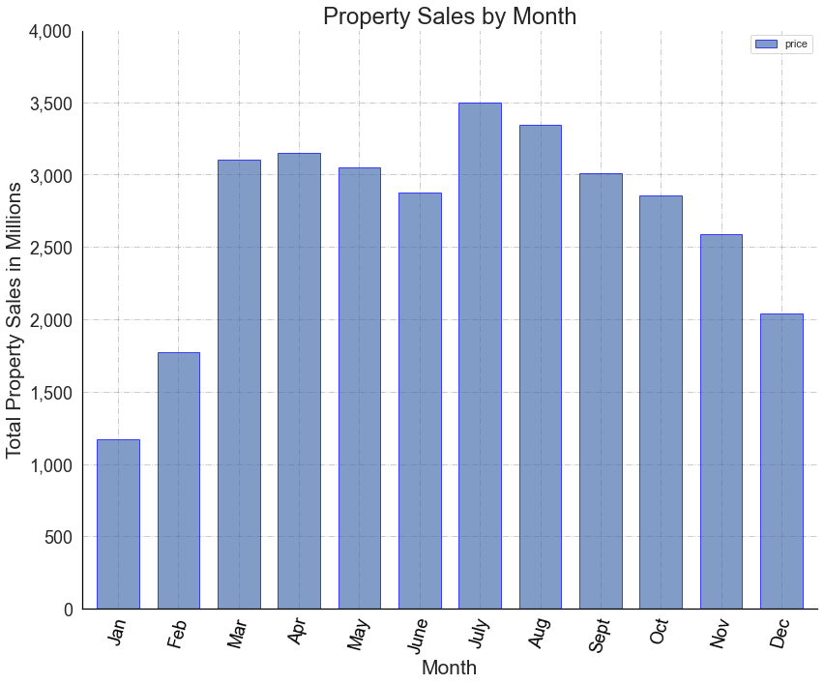
Market Timing
Worst Months
January/February
Best Months
July/August
Notes:
-Charles, above is the market timing, suppl

Slide 7


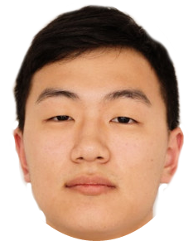
Our Predictive Model
Notes:
Charles but passes to Garrett; refine the text and use words to fill in the text (Truncate, model predicts within $10k)
Clarify what they mean

Slide 8
Key Features that Impact Price
Square footage of living space
Zip Code
Waterfront property
Grade of the house
View of the house
Notes:
What our model determines or predicts the price of real estate off
-Garrett

Slide 9
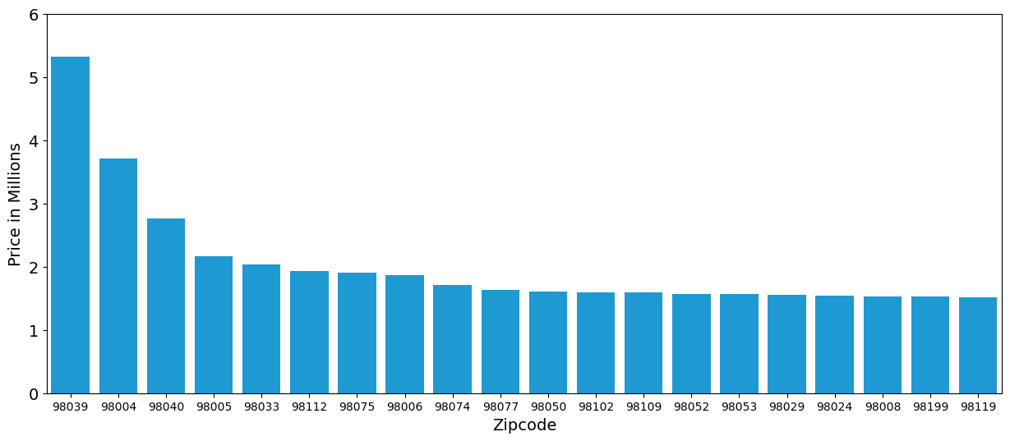
Average Price by Zip Code
Notes:
Give reason why these features matter!
What our model determines or predicts the price of real estate off Fix slide
-Garrett
Only show a f

Slide 10
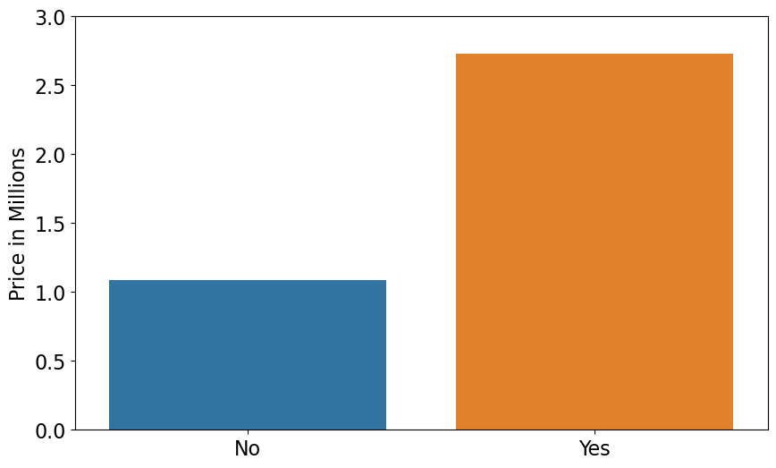
Average Price by Waterfront Property
Notes:
Give reason why these features matter!
What our model determines or predicts the price of real estate off
-Garrett

Slide 11
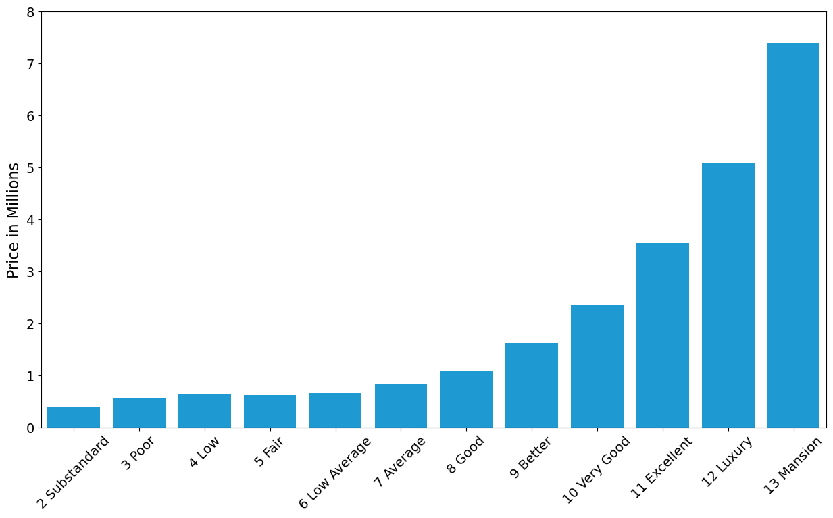
Average Price by Grade
Notes:
Give reason why these features matter!
What our model determines or predicts the price of real estate off
-Garrett

Slide 12
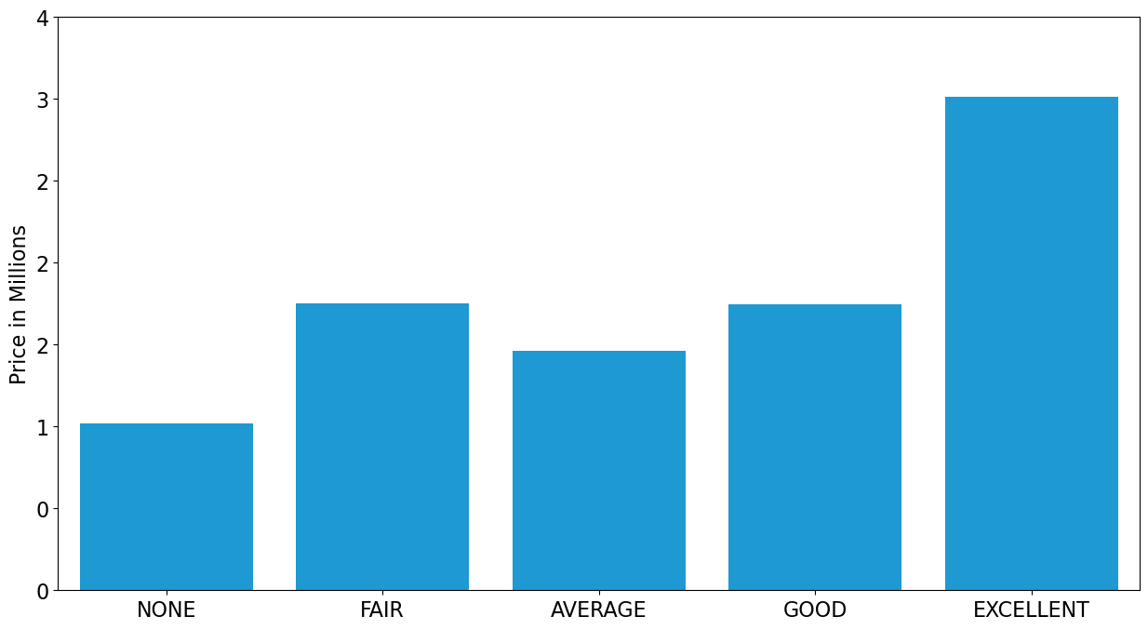
Average Price by View
Notes:
Give reason why these features matter!
What our model determines or predicts the price of real estate off
-Garrett

Slide 13
Results of Our Model
The model can explain 75% of variation in price
On average our model can predict price with a margin of error of $10,000.
Notes:
What our model determines or predicts the price of real estate off
-Garrett

Slide 14
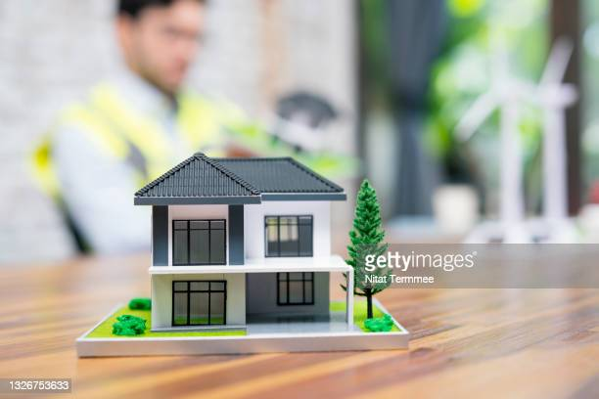
Our
Proposal
Notes:
We are here to provide information on the best location as well as the price range of recommended locations through our predictive model.
-Garrett -> Jordan

Slide 15
Rec 1: Enumclaw
View / Grade
Square Footage
2100 sqft median
Good View
Fair Quality
Zipcode
$702,863
98022
Estimated Price for Building
Notes:
* For the 98022 zipcode, this gives you scenic views of Mt. Rainier.
The negative being this is outside of Seattle and could limit the amount of people coming to see your 3d model home.
-Jordan - Find a real house to indicate its real

Slide 16
Rec 2: Federal Way
View / Grade
Square Footage
2100 sqft median
Good View
Fair Quality
Zipcode
$652,313
98023
Estimated Price for Building
Notes:
* For the 98023 zipcode, this would be a good option for a cheap home in an upcoming neighborhood outside of Seattle.
-Jordan

Slide 17
Rec 3: Seattle
View / Grade
Square Footage
2100 sqft median
Good View
Fair Quality
Zipcode
$1,309,701
98199
Estimated Price for Building
Notes:
* For the 98199 zipcode, located in the heart of Seattle this is a prime location for gathering investors with views of Elliot Bay and Seattle proper
Note: For further inquiries, we can change our parameters to find better recommendations that will suit your need
-Jordan

Slide 18
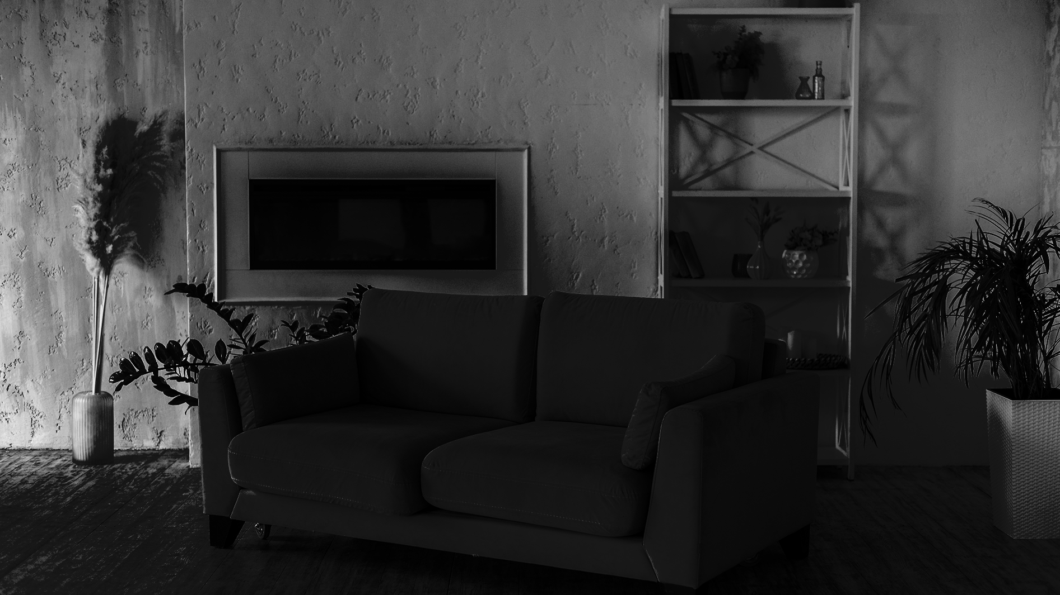

Any Questions?
Notes:
-Jordan

Slide 19



Contact Us
Jordan Mang
Garrett Hall
Charles Pan
Email: Jordanmang@gmail.com Linkedin: www.linkedin.com/in/jordan-mang
Github: https://github.com/JordanMang
Email: garrett.hall.433@gmail.com Linkedin:www.linkedin.com/in/garrett-hall-b10a45189/
Github: https://github.com/Garretthall27
Email: charlesmpan@gmail.com Linkedin: www.linkedin.com/in/charlesmpan
Github: www.github.com/charlesmpan
Notes:
end

